Slide 1
CHEM 001C – CHEMISTRY FOR ENGINEERS
Department of Environmental and Sanitary Engineering Technological Institute of the Philippines – Q.C
Engr. Andrey Joshua Antiporta - Presentor

Slide 2
Materials Chemistry
Crystalline Structure and Material Science

Slide 3
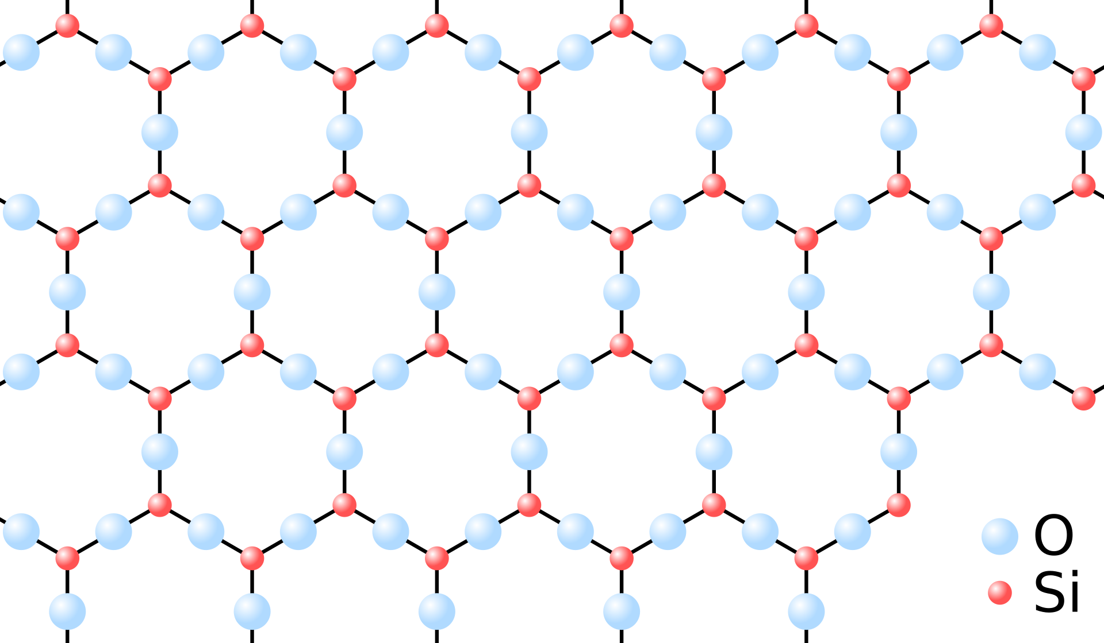
Solids
Solid - one of the four fundamental states of matter
The molecules in a solid are closely packed together and contain the least amount of kinetic energy.
A solid is characterized by structural rigidity and resistance to a force applied to the surface.

Slide 4
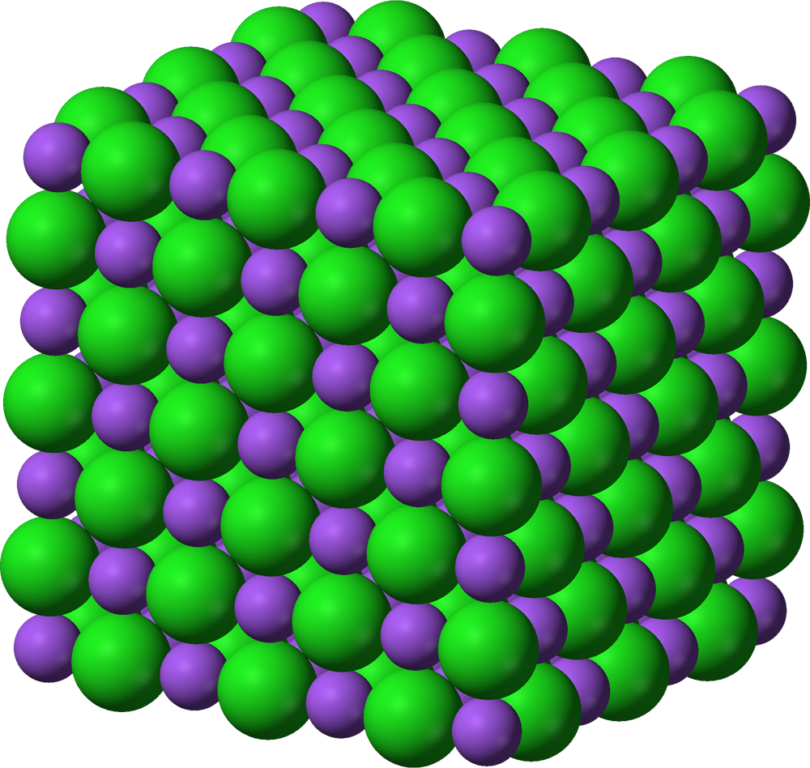
Solids
Solid - one of the four fundamental states of matter
The molecules in a solid are closely packed together and contain the least amount of kinetic energy.
A solid is characterized by structural rigidity and resistance to a force applied to the surface.

Slide 5
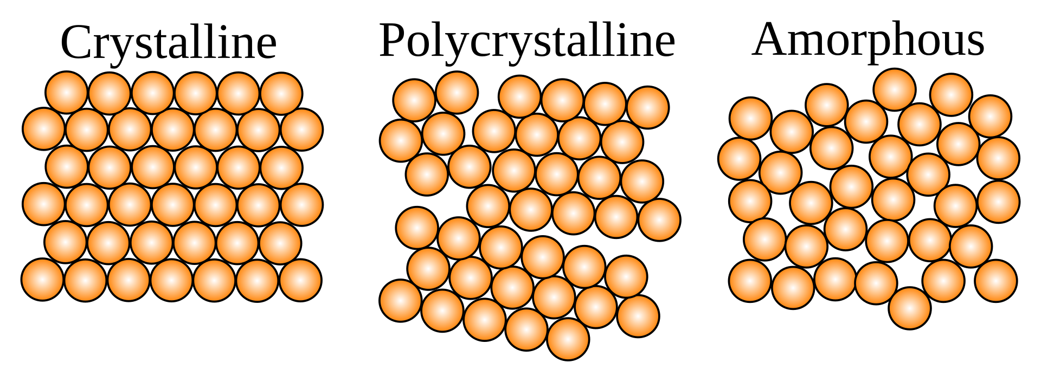
Crystalline Solids
Crystalline Structure
Almost perfect geometric arrangement of molecules (periodic arrangement)

Slide 6
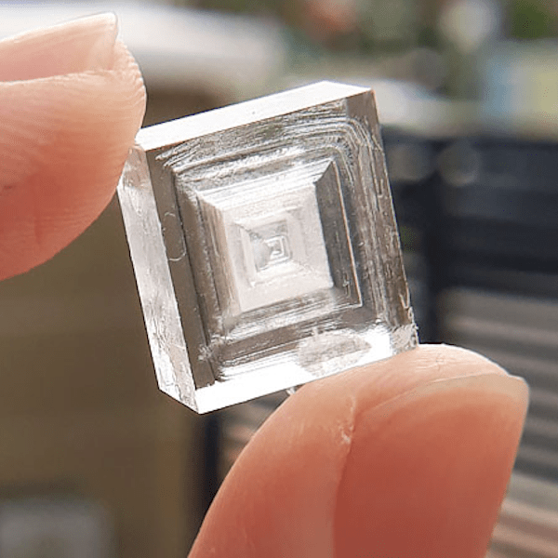
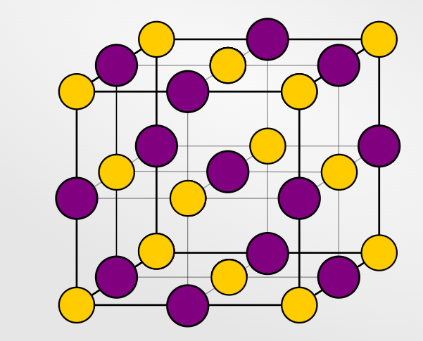
Crystalline Solids
Crystalline Structure
Almost perfect geometric arrangement of molecules (periodic arrangement)
Can be hard and brittle

Slide 7
Crystalline Solids
Polycrystalline Structure
Polycrystalline or crystallite is a small or even microscopic crystal which forms, for example, during the cooling of many materials
Has unique strength

Slide 8
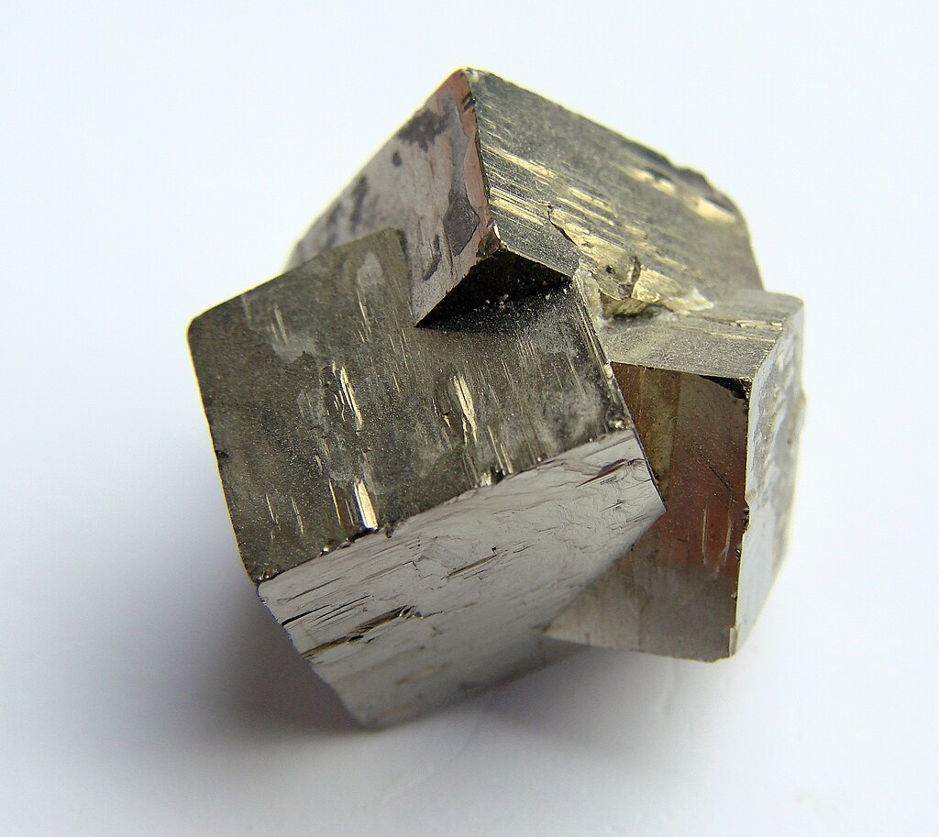
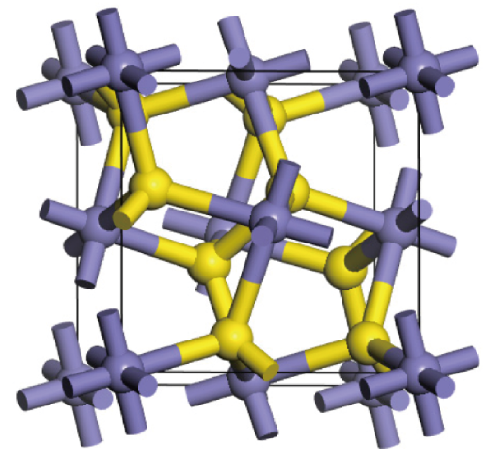
Crystalline Solids
Polycrystalline Structure
Polycrystalline or crystallite is a small or even microscopic crystal which forms, for example, during the cooling of many materials
Has unique strength

Slide 9
Crystalline Solids
Amorphous solid
Solids that are neither crystalline nor polycrystalline
These have no periodic order

Slide 10
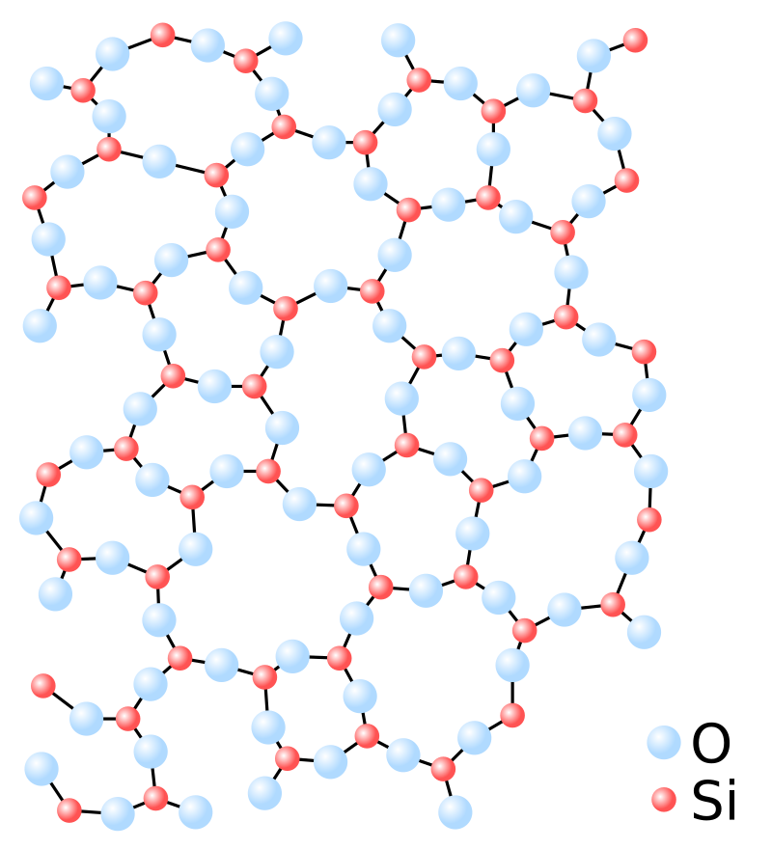
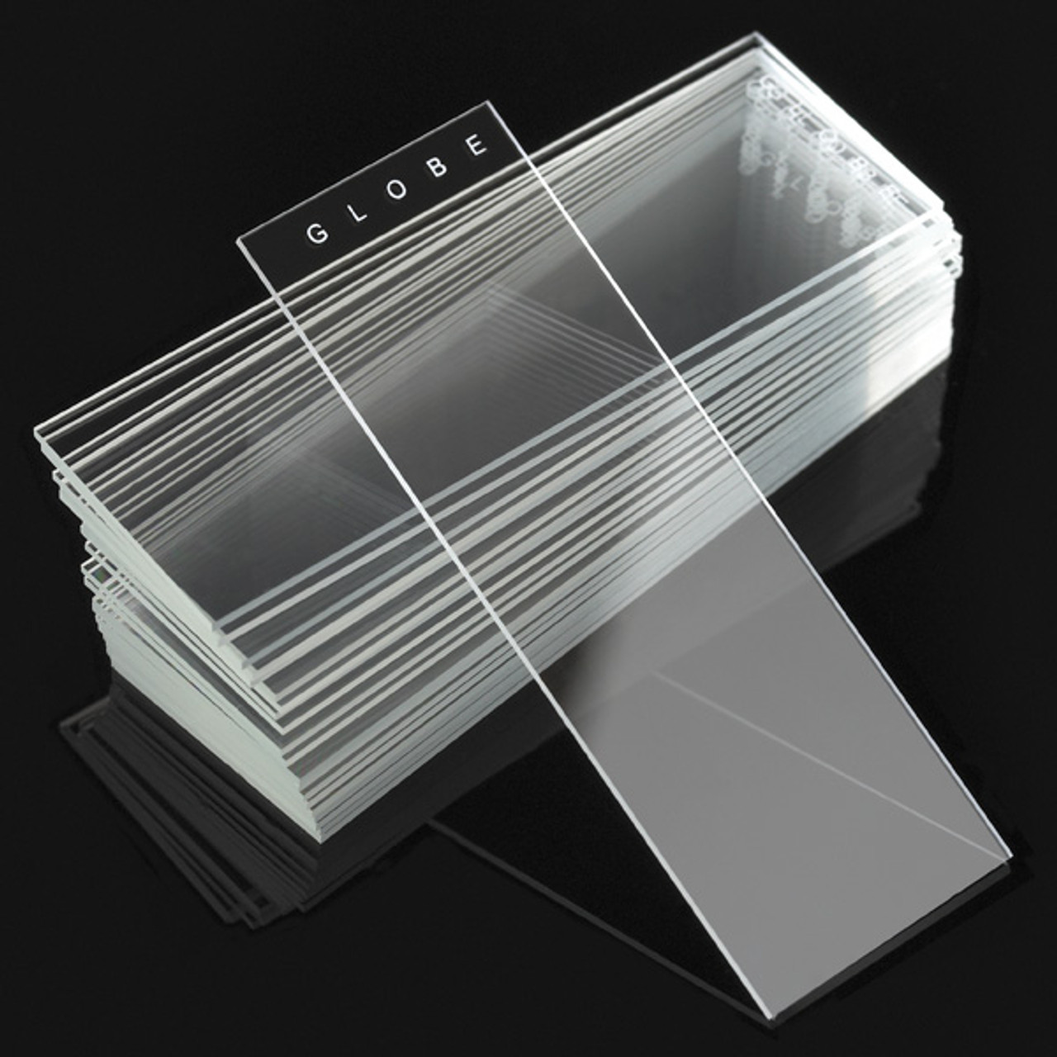
Crystalline Solids
Amorphous solid
Solids that are neither crystalline nor polycrystalline
These have no periodic order
Easy to break/shatter

Slide 11
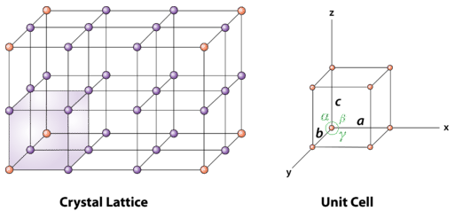
Unit Cell
A unit cell is the smallest portion of a crystal lattice that shows the three-dimensional pattern of the entire crystal.

Slide 12
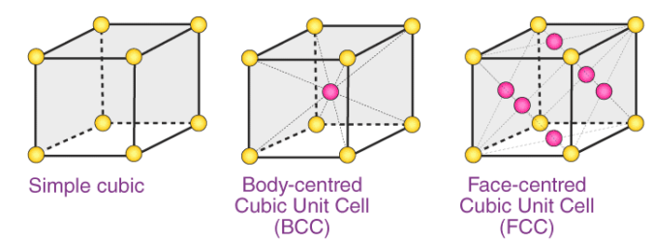
Unit Cell
A unit cell is the smallest portion of a crystal lattice that shows the three-dimensional pattern of the entire crystal.

Slide 13
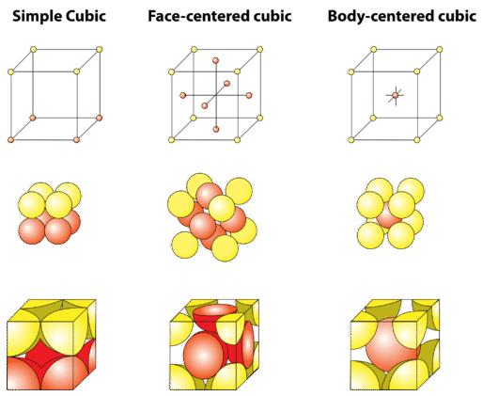
Unit Cell
A unit cell is the smallest portion of a crystal lattice that shows the three-dimensional pattern of the entire crystal.

Slide 14
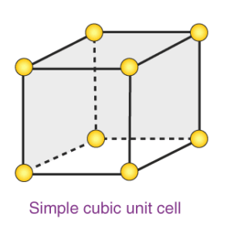
Unit Cell
Simple Cubic Cell -In each cubic unit cell, there are 8 atoms at the corners.
Therefore, the total number of atoms in one unit cell is 8 × 1/8 = 1 atom.
Coordination No. : 6

Slide 15
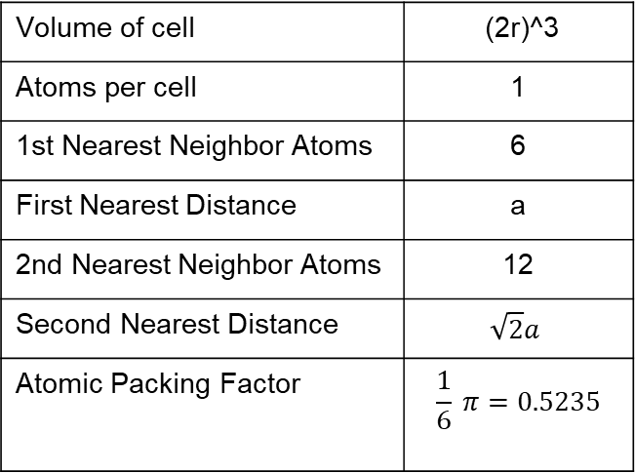
Unit Cell
Volume of cell | (2r)^3
Atoms per cell | 1
1st Nearest Neighbor Atoms | 6
First Nearest Distance | a
2nd Nearest Neighbor Atoms | 12
Second Nearest Distance | $$\sqrt{2}a$$
Atomic Packing Factor | $$\frac{1}{6} π=0.5235$$

Slide 16
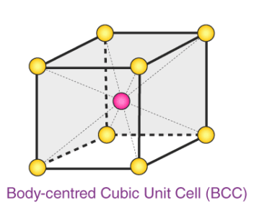
Unit Cell
A BCC unit cell has atoms at each corner of the cube and an atom at the center of the structure.
Therefore, the total number of atoms in one unit cell is 8 × 1/8 + 1 atom = 2 atom.
Coordination No.: 8

Slide 17
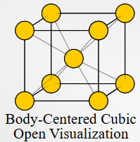
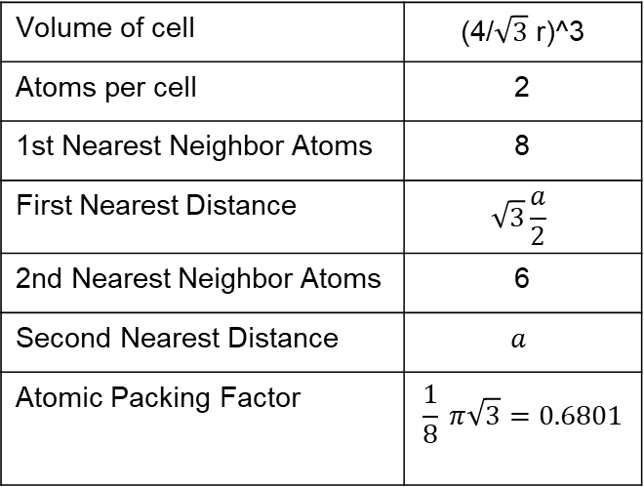
Unit Cell
Volume of cell | (4/$\sqrt{3}$ r)^3
Atoms per cell | 2
1st Nearest Neighbor Atoms | 8
First Nearest Distance | $$\sqrt{3}\frac{a}{2}$$
2nd Nearest Neighbor Atoms | 6
Second Nearest Distance | $$a$$
Atomic Packing Factor | $$\frac{1}{8} π\sqrt{3}=0.6801$$

Slide 18
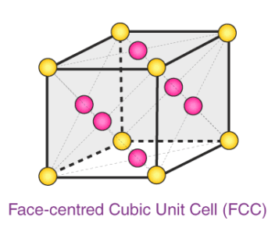
Unit Cell
An FCC unit cell contains atoms at all the corners of the crystal lattice and at the center of all the faces of the cube.
Coordination No.: 12

Slide 19
Unit Cell
Coordination No.: 12
a) 8 corners × 1/8 per corner atom = 8 × 1/8 = 1 atom
b) 6 face-centered atoms × 1/2 atom per unit cell = 3 atoms

Slide 20
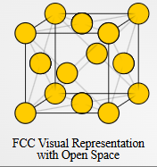
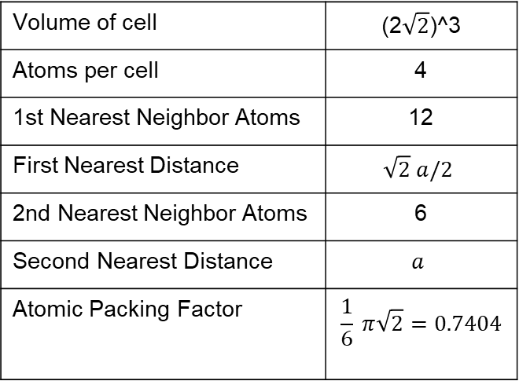
Unit Cell
Volume of cell | (2$\sqrt{2}$)^3
Atoms per cell | 4
1st Nearest Neighbor Atoms | 12
First Nearest Distance | $$\sqrt{2} a/2$$
2nd Nearest Neighbor Atoms | 6
Second Nearest Distance | $$a$$
Atomic Packing Factor | $$\frac{1}{6} π\sqrt{2}=0.7404$$

Slide 21
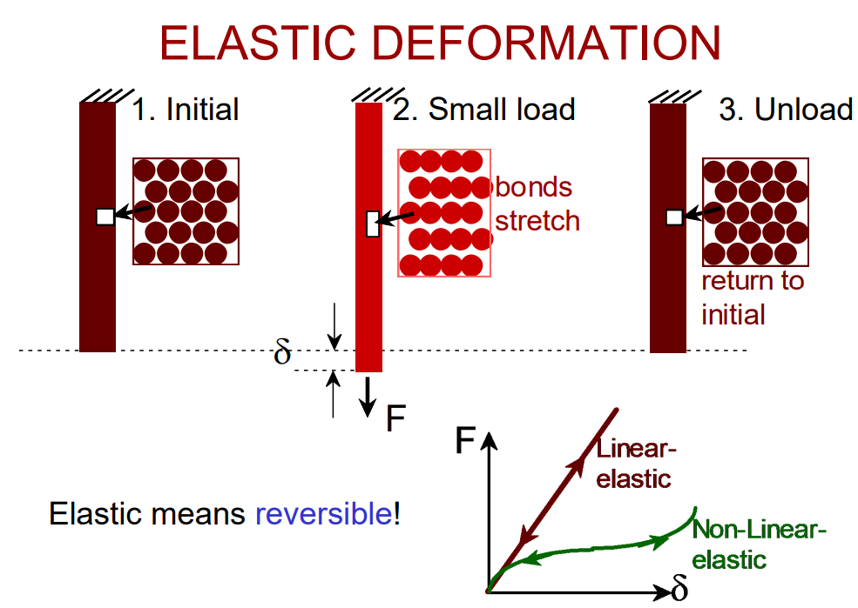
Thanks for Listening

Slide 22
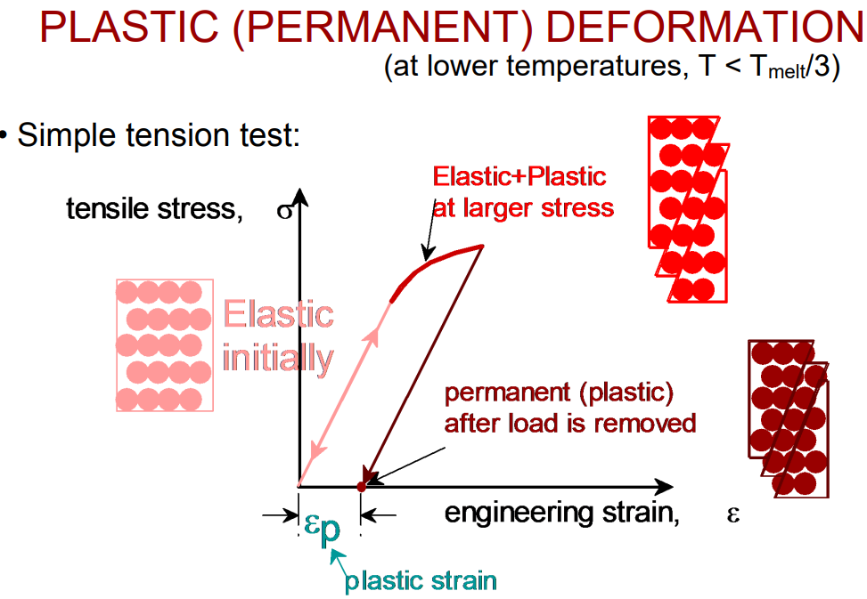
Thanks for Listening

Slide 23
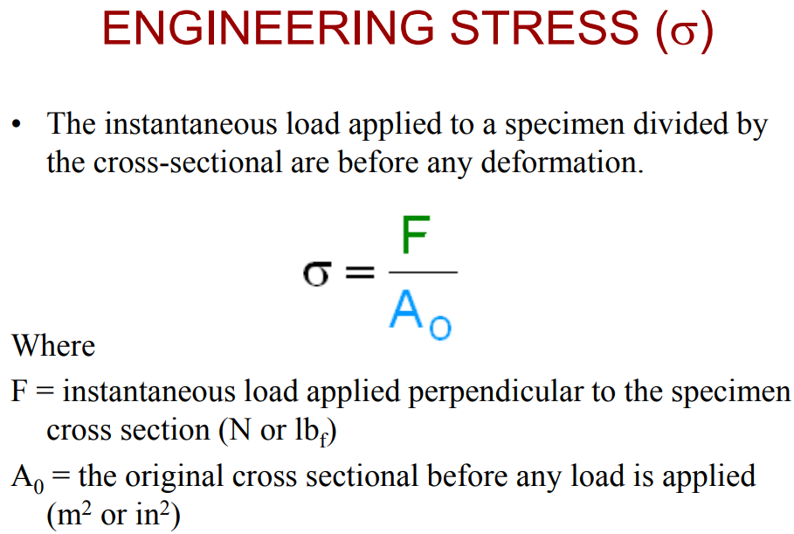
Thanks for Listening

Slide 24
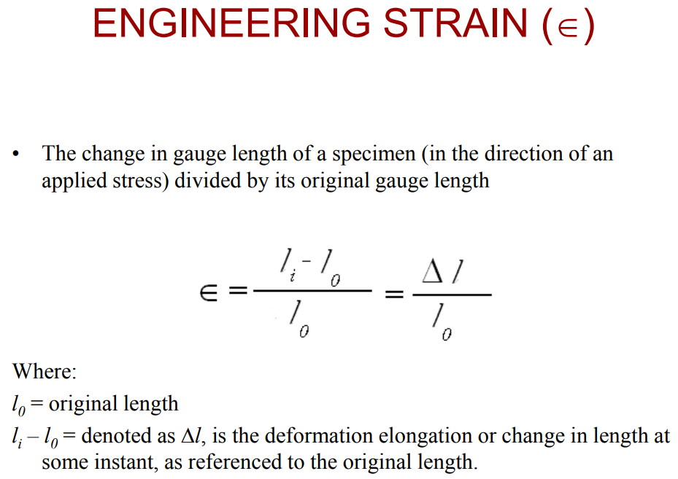
Thanks for Listening

Slide 25
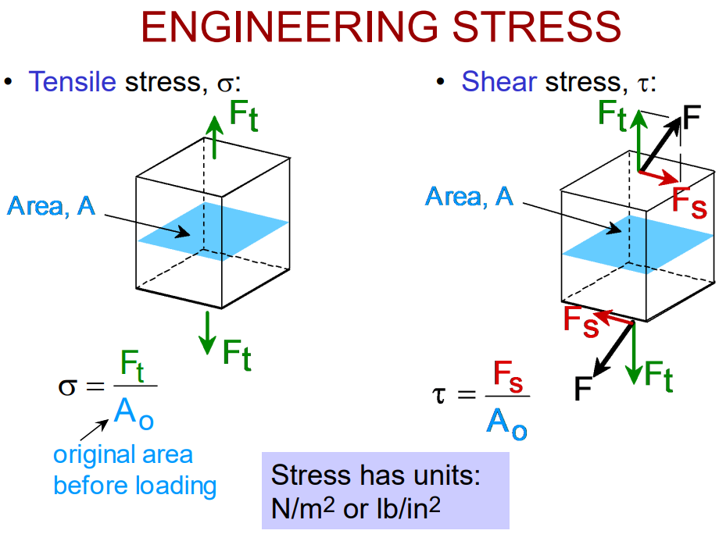
Thanks for Listening

Slide 26
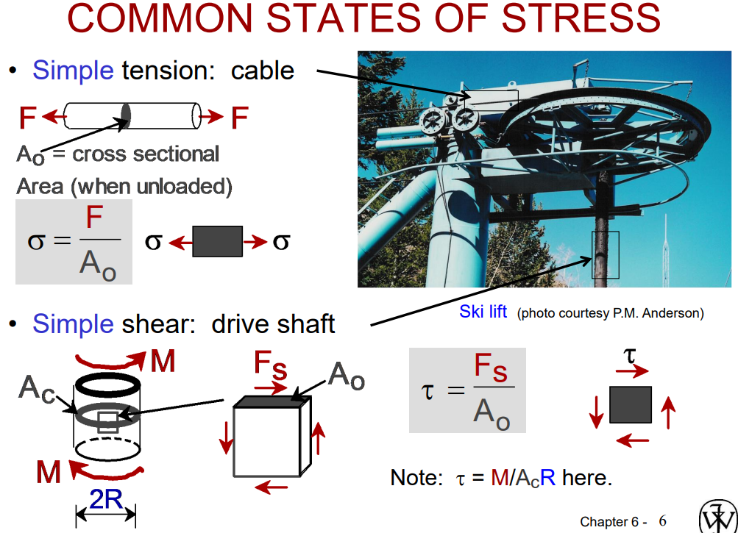
Thanks for Listening

Slide 27
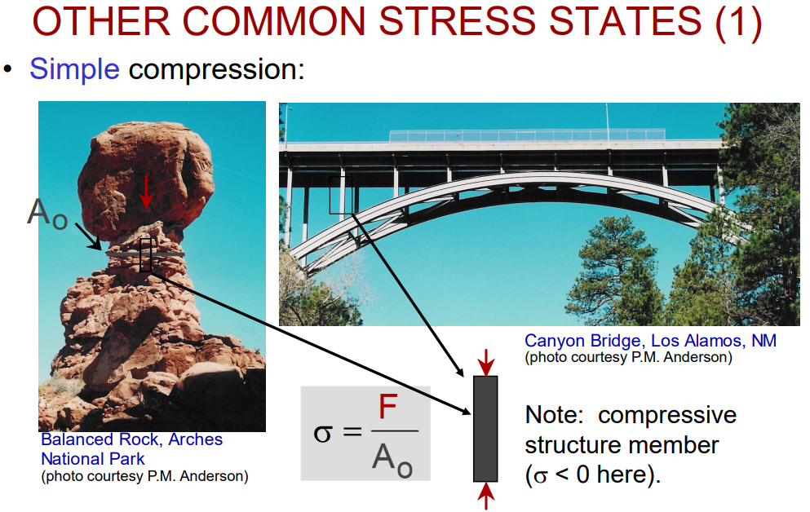
Thanks for Listening

Slide 28
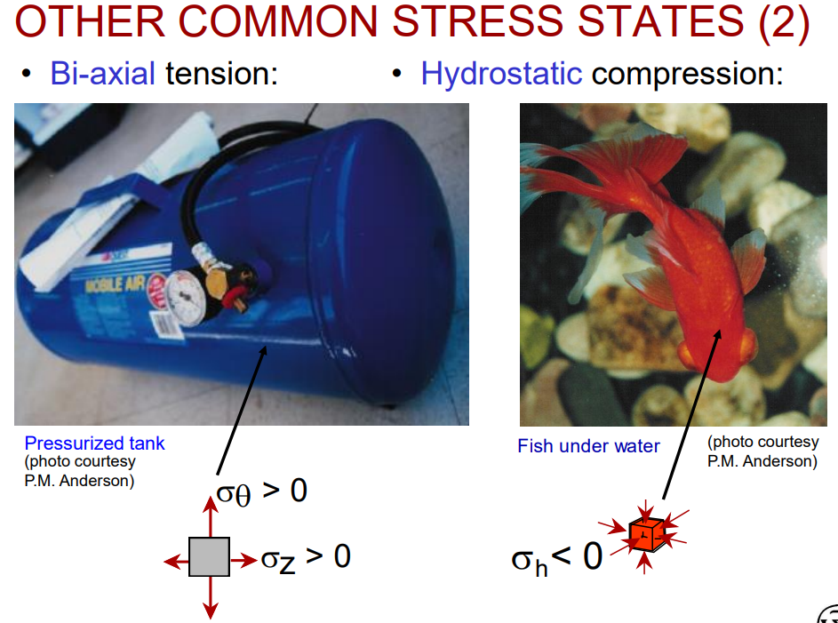
Thanks for Listening

Slide 29
Thanks for Listening
An square aluminum beam with a thickness of 15mm is subjected to a tensile force of 100 kN. Calculate the tensile stress in the beam.
A 5 pieces of thin steel wire with a cross-sectional area of 0.1 mm² is arranged so that it is subjected to a force of 15 kN. Calculate the tensile stress in the wire.
A square steel bar with a length of 4 meters and thickness of 6mm is subjected to a tensile force of 10,000 N. Calculate the stress in the bar.
A 2 pieces of copper wire with a diameter of 2 mm is stretched by a force of 550 N. Determine the stress in the wire.

Slide 30
Thanks for Listening
CHEM 001 – CHEMISTRY FOR ENGINEERS

